Slide 1
Shrine Bowl x Sū mer Sports 2026 Analytics Competition
OL-DL Drill Evaluation
from Tracking Data
99
68
Automated Data Pipeline to Advanced Metrics for Interior Linemen
Submission by Dan Falkenheim

Slide 2


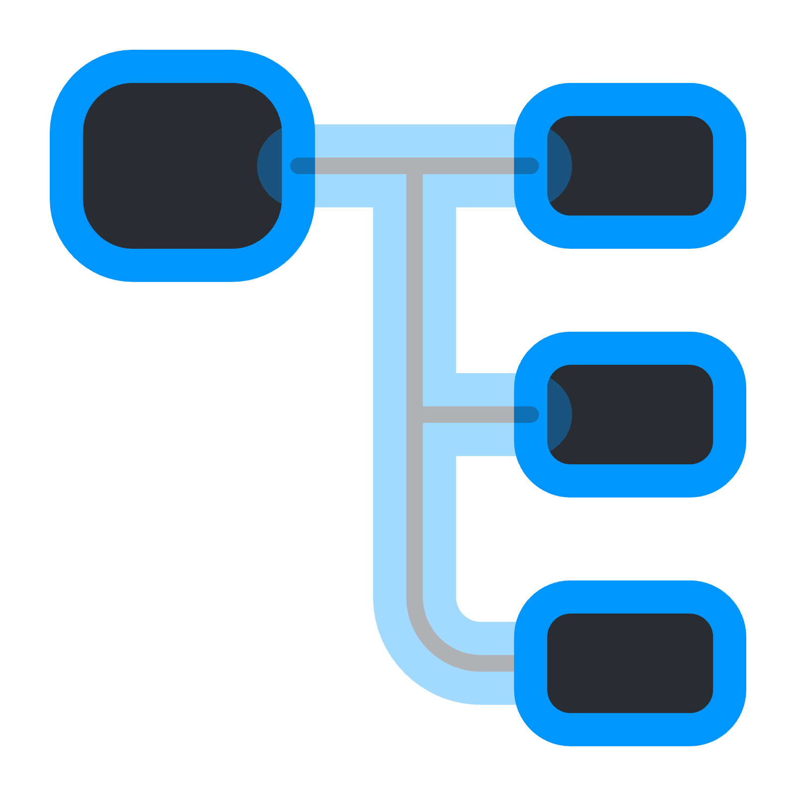



END-TO-END WORKFLOW
Converting Raw Tracking Data Into Meaningful Metrics
The Problem
The Solution: An automated, reproducible workflow
01
Inputs are continuous stream of Zebra tracking data without distinct “stop” or “start” markers for individual reps or labels for which two players are participating in the active rep.
Input: Raw Tracking Data
Scan to collect drill session start and end timestamps, OL and DL jersey numbers, and the LOS (manual)
Step 1: Automated Rep Detection
Run an algorithm over the entire drill period to detect 12-second windows where an individual rep may have taken place, and then run a second, local algorithm that extracts rep start and rep end frames
Step 2: Feature Engineering
Define engagement windows, approximate contact onset, pair player names and positions with individual tracking IDs, and label edge vs. interior matchups
Output: Performance Metrics
Compute how much depth a defensive lineman gained or an offensive lineman allowed, and measure power (bull rushes, DL walking the OL back) and stalls (anchor, OL neutralizes DL) proxies
02
Manual charting can be slow and hard to scale.
03
An individual 1-on-1 OL-DL rep has several phases (get off, set, engagement, anchor, finish) and properly quantifying a lineman’s performance requires phase-aware measurements that anchor to consistent events.

Slide 3

AUTOMATED DETECTION
Data Pipeline Framework
Outer Algorithm: Search for candidate reps, provide window to inner algorithm, proceed until end of session
The trigger: DL crosses normalized Line of Scrimmage threshold (x = 0.5).
Pass time slice [-4.0 seconds, +8.0 seconds] from frame to local algorithm
Rep 1
Rep 2
Rep 3
Inner Algorithm
Pair Identification: Score each OL-DL pair by active close frames (distance < 2.0 yards while both players’ speeds > 1.0). Pick highest scoring pair.
Rep Start: Pick earliest frame where pair’s combined speed or acceleration crosses given threshold
Rep End: Pick first frame where a) either player is moving back toward LOS over sustained frames or b) rep stagnates over a given duration
The algorithm returns a dataframe with all of the identified frames between the OL-DL pair for each rep across a given practice session. Required manual inputs are OL and DL jersey numbers, the timestamps for the drill period, and the line of scrimmage.

Slide 4
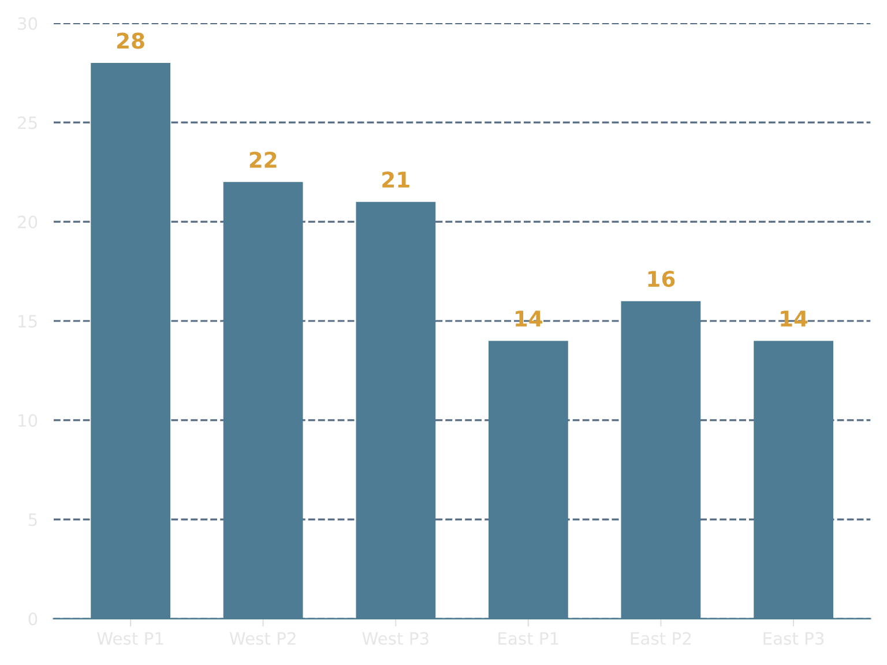



AUTOMATED DETECTION
Data Pipeline Framework Validation
Performance Against Manually Charted Frames for 2024 West Practice 2
Processing Results Across Sessions After Filtering
Manually Charted Reps | Detected Reps
*Start Frame Error (M)
23 24
~2.39 frames
One false positive
(1.6s)
End Frame Error (MAE)
Matchup Identification
~3.96 frames
23/23 correct pairs
(1.9s)
*When removing one false positive
Notes
*Manual labeling on West Practice 1 (used to tune algorithm) surfaced combined speed/accel thresholds later used in algorithm; start frame error not wholly independent.
133 reps and 5,345 frames identified across six 2024 practice sessions
9 false positives and 9 other reps with data quality issues filtered out (18/133; ~13.5%)

Slide 5
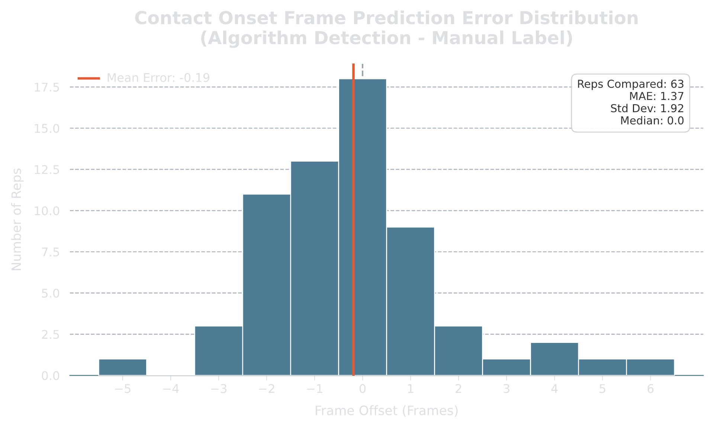
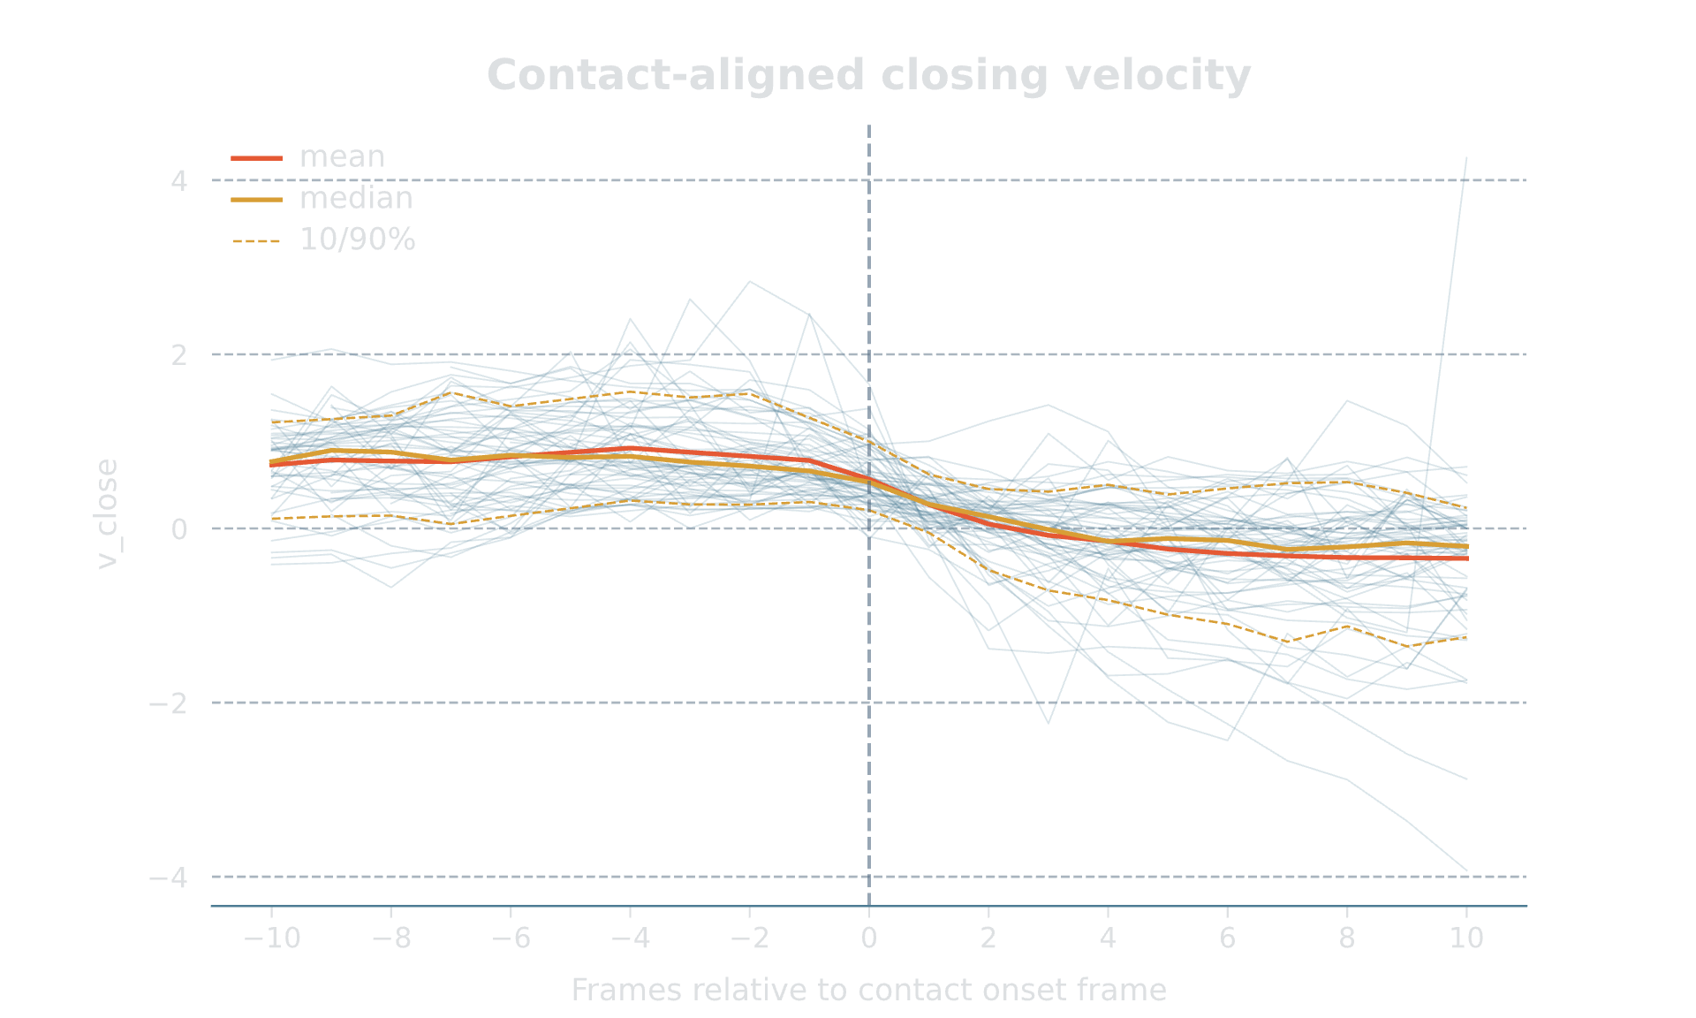


FEATURE ENGINEERING
Contact Onset Detection & Other Features
Challenge
Solution: Two-Step Detection Process
(*Approximate) Interior Validation Results
1
Engagement Window: Coarse filter. Engagement begins once OL and DL cross a pairwise distance threshold and are closing, ends when pairwise distance exceeds different distance threshold and OL-DL pair are separating.
Looking For an Engagement Window
An individual 1-on-1 rep has confounding factors (how much of a DL’s depth gained is earned vs. how much is due to the OL’s natural retreat?) that can make quantifying performance difficult. Without film to rely on and validate against, finding a consistent reference point is tricky.
2
Contact Onset Point: Fine filter. Identify candidate frames where distance is under given threshold, most frames are closing and closing isn’t trivial. Find first frame where 2 of 3 confirmation signals (closing-speed collapse, coupling, impact spike) fire. Use engagement window start as fallback.
Why approximate? (An important caveat)
Other Features
T
Matchup Labeling: Quickly label reps as edge or interior by hand, second pass to clean with code where positions (DT vs. OG/OC, DE vs. OT) align. (Extra Trees classifier achieves high accuracy vs. manual labels.)
There is no film to validate when contact began. Instead, manually labeled contact onset frames were identified through rough heuristics surrounding regime change. (Meaning, when does a rep look like it has exited the closing phase and entered a coupled engagement phase?) As such, the “contact onset frame” can only be viewed as a very rough approximation for when contact onset may have occurred, and should not be considered ground truth. However, if the contact-aligned closing velocity chart on the left is taken into account, the contact-onset frame can be seen as a reasonable proxy for a moment when closing velocity is about to collapse and players enter a sustained period of engagement.
Player Information: Join player-level information (name, position, weight, draft outcomes) onto unique player IDs. Add information for missing players based on official East-West Shrine Bowl rosters where possible.

Slide 6

PERFORMANCE METRICS AND RESULTS (OL)
Primary Metric: DL Depth Allowed (or Gained) at Frame 25
Why frame 25?
Interior OL Performance (Frame 25)
Player
Median Depth Allowed
NFL Outcome (2 years)
In 2025, the median time to throw for NFL quarterbacks was about 2.68 seconds. Next Gen Stats has previously defined a "quick pressure" as a pressure occurring within the first 2.5 seconds of a play and has said the average pressure occurred within 2.9 seconds. Likewise, ESPN Analytics' pass rush win rate metric quantifies "how often a pass rusher is able to beat his block within 2.5 seconds". As such, frame 25 is a reasonable time at which to evaluate the depth gained by the defensive lineman.
Draft Outcome
Mason McCormick
2.38 yards
4th round
31 games started, 34 games played
4 reps
Dylan McMahon
3.02 yards
6th round
1 game started, 1 game played
5 reps
Kaitori Leveston
3.09 yards
7th round
7 games started, 16 games played (switched to tackle)
4 reps
Christian Mahogany
3.22 yards
6th round
12 games started, 18 games played
4 reps
Hunter Nourzad
3.38 yards
5th round
0 games started, 28 games played
4 reps
Why depth allowed (or gained) by the DL?
X’Zauvea Gadlin
3.39 yards
Undrafted
0 games started, didn’t make a roster
4 reps
Karsen Barnhart
3.42 yards
Undrafted
0 games started, made practice squad
The basic idea is that depth penetration (x-axis) at 2.5 seconds is a potential proxy for whether the interior DL beat his block, walked the OL back, gained a negligible amount of depth, or stalled out. In turn, interior OL can be evaluated by examining how much depth they allowed the DL to gain. Using one axis avoids over-crediting lateral movement.
4 reps
C.J. Hanson
3.45 yards
7th round
0 games started, 4 games played (mainly special teams)
10 reps
Matt Lee
3.47 yards
7th round
1 game started, 22 games played (special teamer)
5 reps
Willis Patrick
3.54 yards
Undrafted
0 games started, didn’t make a roster
5 reps
Trente Jones
3.56 yards
Undrafted
0 games started, didn’t make a roster/retired (back injury)
4 reps
Donovan Jennings
4.23 yards
Undrafted
0 games started, 2 games played
5 reps

Slide 7
PERFORMANCE METRICS AND RESULTS (DL)
Primary Metric: DL Depth Allowed (or Gained) at Frame 25
Why frame 25?
Interior DL Performance (Frame 25)
Player
Median Depth Gained
NFL Outcome (2 years)
In 2025, the median time to throw for NFL quarterbacks was about 2.68 seconds. Next Gen Stats has previously defined a "quick pressure" as a pressure occurring within the first 2.5 seconds of a play and has said the average pressure occurred within 2.9 seconds. Likewise, ESPN Analytics' pass rush win rate metric quantifies "how often a pass rusher is able to beat his block within 2.5 seconds". As such, frame 25 is a reasonable time at which to evaluate the depth gained by the defensive lineman.
Draft Outcome
Tuli Letuligasenoa
4.54 yards
Undrafted
0 games started, 0 games played (practice squad briefly)
3 reps
Jowon Briggs
4.17 yards
7th round
8 games started, 23 games played
4 reps
Logan Lee
3.95 yards
6th round
0 games started, 7 games played
5 reps
Khristian Boyd
3.60 yards
6th round
0 games started, 10 games played
6 reps
Jordan Miller
3.60 yards
Undrafted
0 games started, 0 games played (practice squad)
3 reps
Why depth allowed (or gained) by the DL?
Jamree Kromah
3.53 yards
Undrafted
0 games started, 0 games played (practice squad)
3 reps
Myles Murphy
3.47 yards
Undrafted
0 games started, 0 games played (didn’t make team)
The basic idea is that depth penetration (x-axis) at 2.5 seconds is a potential proxy for whether the interior DL beat his block, walked the OL back, gained a negligible amount of depth, or stalled out. In turn, interior OL can be evaluated by examining how much depth they allowed the DL to gain. Using one axis avoids over-crediting lateral movement.
7 reps
Evan Anderson
3.38 yards
Undrafted
1 game started, 12 games played
4 reps
Fabien Lovett
3.34 yards
Undrafted
0 games started, 0 games played (practice squad)
6 reps
Zion Logue
3.08 yards
6th round
0 games started, 5 games played
4 reps
Justin Rodgers
3.06 yards
7th round
0 games started, 0 games played (practice squad)
8 reps
Nathan Pickering
2.94 yards
Undrafted
0 games started, 0 games played (waived, injury)
6 reps

Slide 8
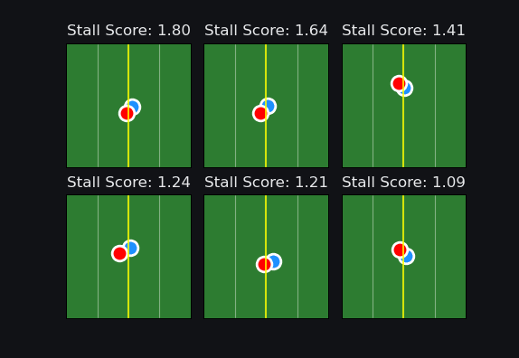

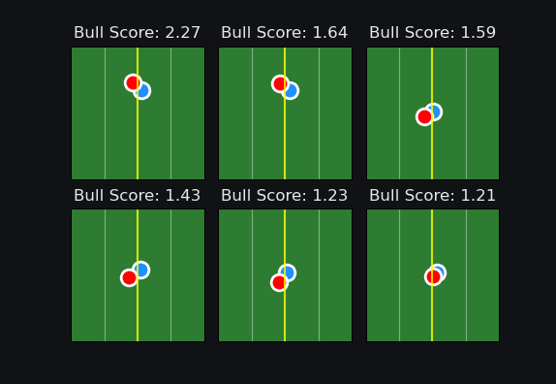

PERFORMANCE METRICS AND RESULTS
Secondary Metrics: Stall and Bull Score
What’s the purpose?
Top 3 OL by Stall Score
Top 6 Reps by Stall Score
DL depth allowed (or gained) can be useful for evaluating interior lineman, but it doesn’t provide context for how a rep was won or lost. It also isn’t phase aware, meaning that the metric doesn’t take into account what is happening in the rep besides depth penetration.
Stall and bull score attempt to create proxies for evaluating anchor (stall) for offensive linemen and power (bull) for defensive linemen by evaluating what happens after the contact-onset point
Player
Stall Score
Kaitori Leveston
0.94
“Leveston showed an excellent punch in 1-on-1's and was able to sit down to absorb bull rushes.”
—Giants.com (1/29/2024)
Mason McCormick
0.87
“McCormick played both guard and center, showing power, good feet, and a nasty streak.”
—Giants.com (1/29/2024)
Christian Mahogany
0.54
“His raw power has people buzzing.” —Windy City Gridiron (1/27/2024)
Stall Score
Arrest Component: Negative AUC of positive closing velocity (how much closing rate slows after contact)
Displacement Component: Absolute change in axis-projected post-contact position (how much the OL moved)
Stall Score = z_{Arrest} - z_{Displacement}
Top 6 Reps by Bull Score
Top 3 DL by Bull Score
Player
Bull Score
Jowon Briggs
1.23
“Briggs won twice in OL/DL 1v1 with his bull rush. Powerful player.”
—Steelers Depot (1/27/2024)
Bull Score
Tuli Letuligasenoa
0.98
Arrest Component
Walk-Back Component: Maximum of 0 and negative displacement along rush axis (OL backward movement only)
Bull Score = z_{Walk-Back} + 0.25*z_{Arrest}
(Weighting introduced to keep bull = walk-back given engagement)
“Letuligasenoa showed off an impressive bull rush.”
—Steelers Depot (1/27/2024)
Myles Murphy
0.97
“Murphy … played like a bowling ball with spikes during 1-on-1 matchups.” —All Access Football (2/7/2024)

Slide 9

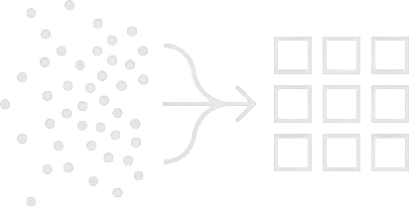

CONCLUSION
Important Notes, Recap, and Final Thoughts
Limitations
Extensions of the Framework (Not Pursued)
Small sample size. Reps have been pulled from 2024 East-West Shrine Bowl practice alone, and many players only have around three or four reps. 10 seconds worth of data (or ~2 seconds for the secondary metrics!) can’t paint a full picture or be used as a comprehensive evaluation. Without more data, the metrics are best seen as tracking-based proxies for interior OL/DL performance.
Lack of film-based validation. The gold standard for manual labeling is to match the timestamps/frames of events with the same reference points on film. Features like rep start, rep end and contact onsets are rough approximations and are not validated against ground truth (film). Metrics can be sensitive to frame errors of three frames and beyond
Analyze edge reps. DE-OT reps have a different texture (wider rush axis) and require different metrics that appropriately handle lateral displacement. The data is there to quantify “bend” (i.e., speed and tightness through a turn while “gaining” on an OL).
Use general pipeline idea for other individual reps. The automated pipeline was developed by taking advantage of the specific movement signatures of 1-on-1 OL-DL reps, like a DL always crossing a specific yardage threshold if they are involved in a rep. Other reps are obviously different, but repeated movement specifics may be found. (Or, if there’s a snap of the football, even better.)
RECAP
Unstructured Data to Segmented Reps
Relevant Features from Segmented Data
Meaningful Metrics that Quantify Interior Play
Given a few manual inputs, an automated algorithm can loop through six practice sessions and return frames for the identified OL-DL pairs in a tidy format in less than a minute.
Relevant observables, like the contact-onset point and matchup type, are extracted from the data and used to provide context-aware identifiers for use in building metrics
Depth allowed at frame 25, as well as stall and bull score, show some correlation to NFL outcomes and what on-the-ground media report in their writeups

Slide 10
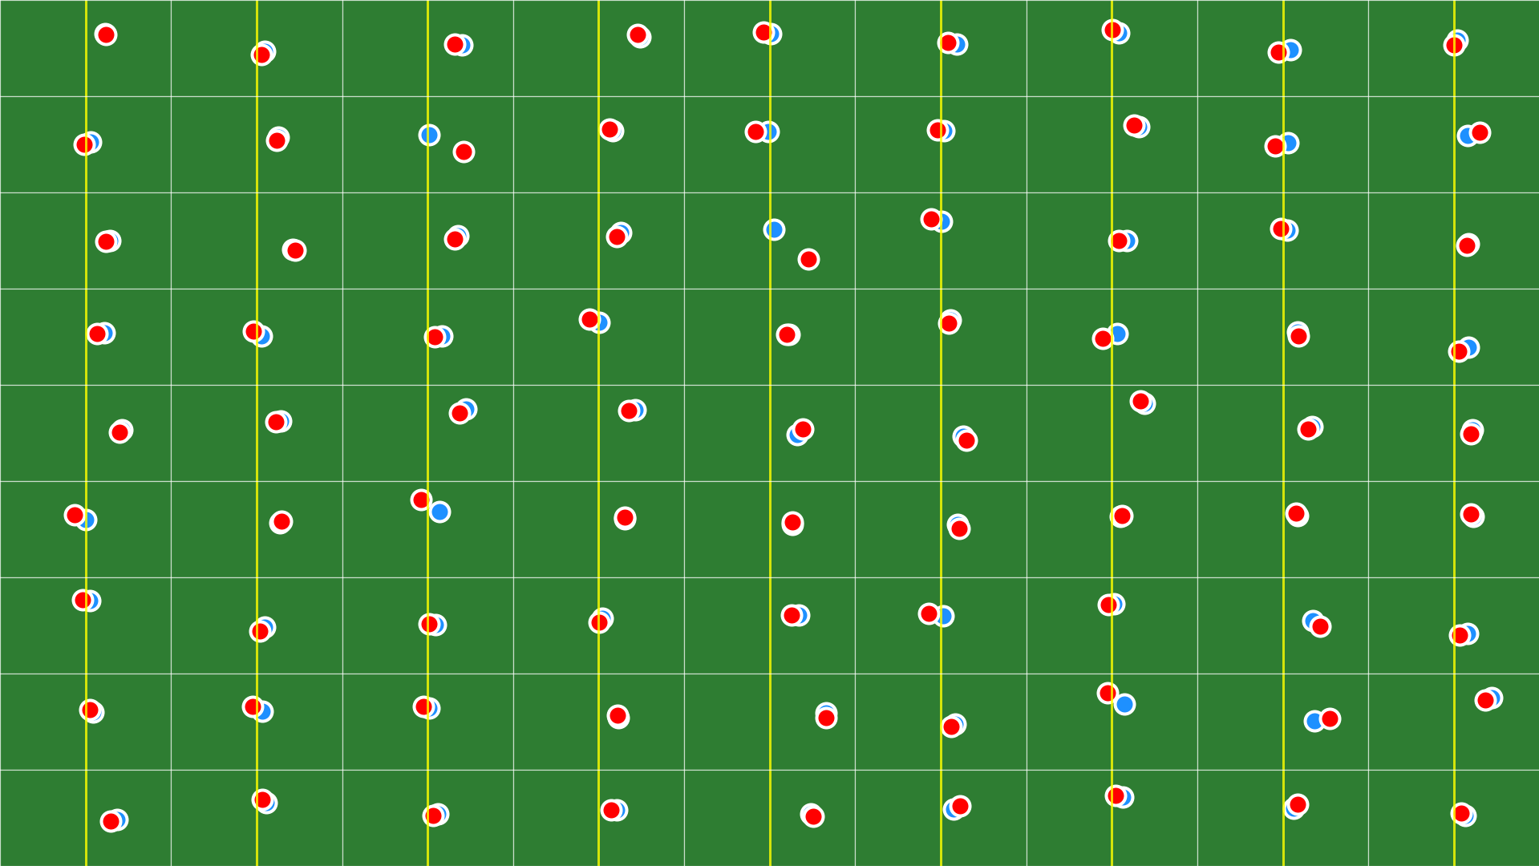
Thank you!
Shrine Bowl x Sūmer Sports 2026 Analytics Competition
Submission by Dan Falkenheim (@thefalkon)

